Slide 1

Design and Development of a RAM-based PUF
Zissis Tabouras (s284685)
Elena Roncolino (s304719)
Stefano Palmieri (s281677)

Slide 2
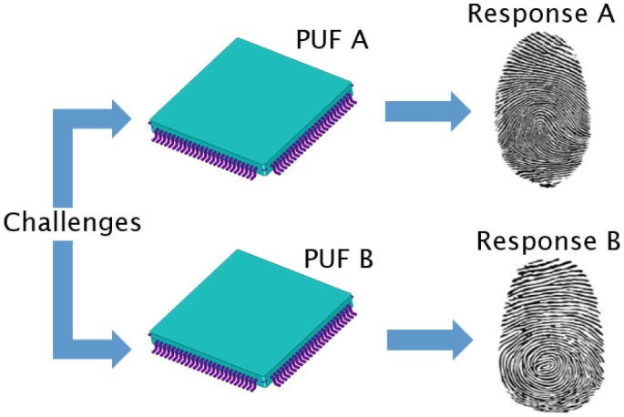
What is a PUF?

Slide 3
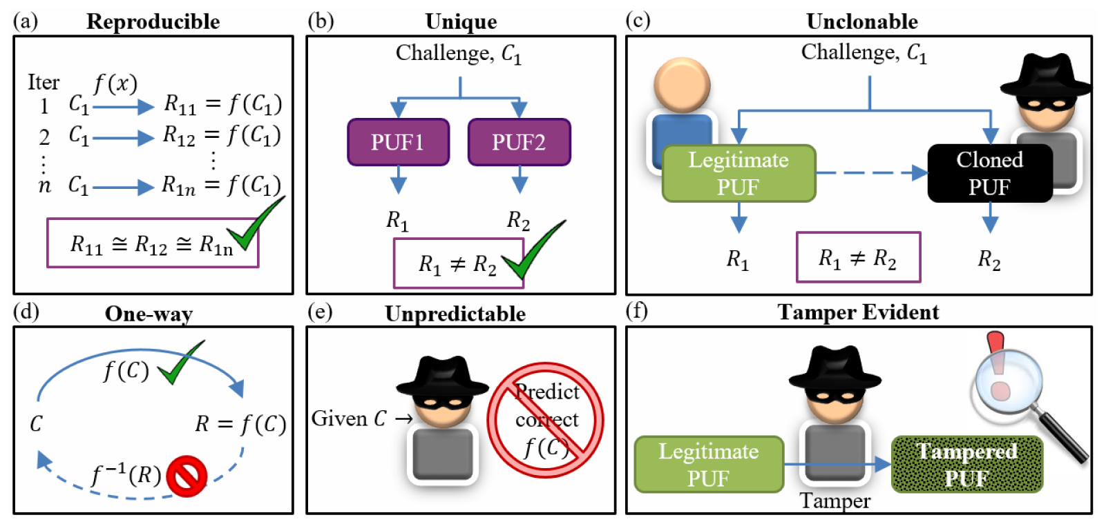
Why PUF is important?

Slide 4
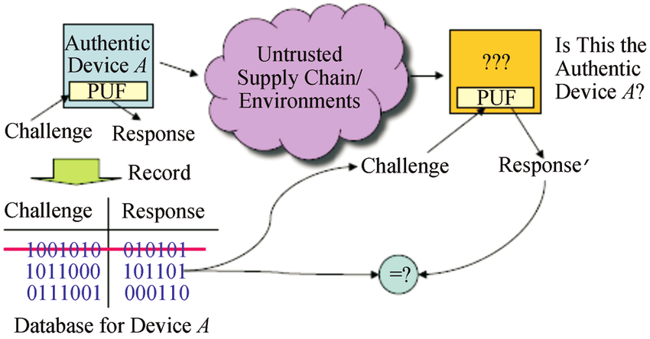
How PUF works?

Slide 5
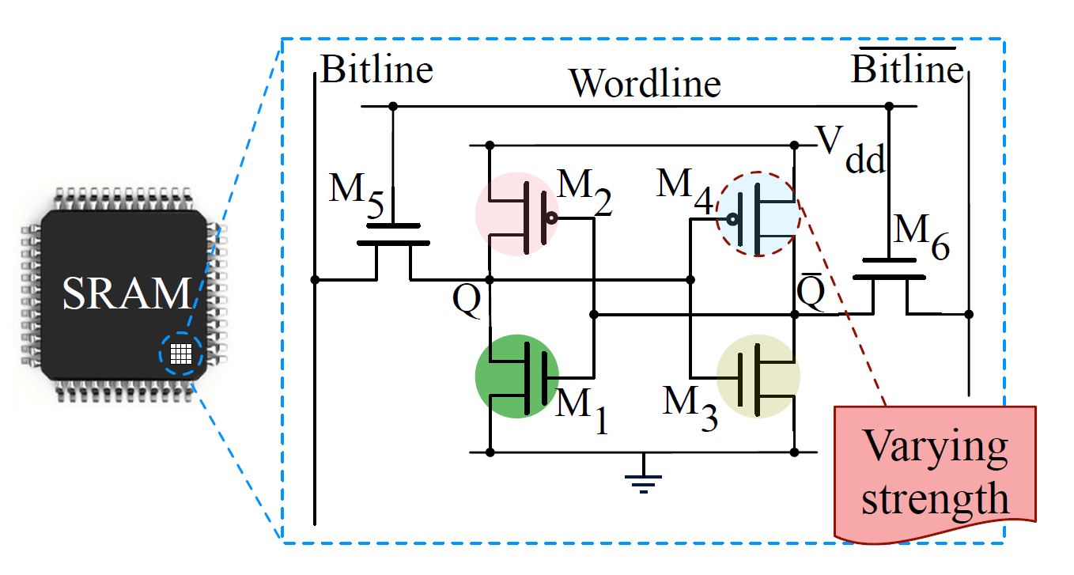
Which PUF implemented?

Slide 6
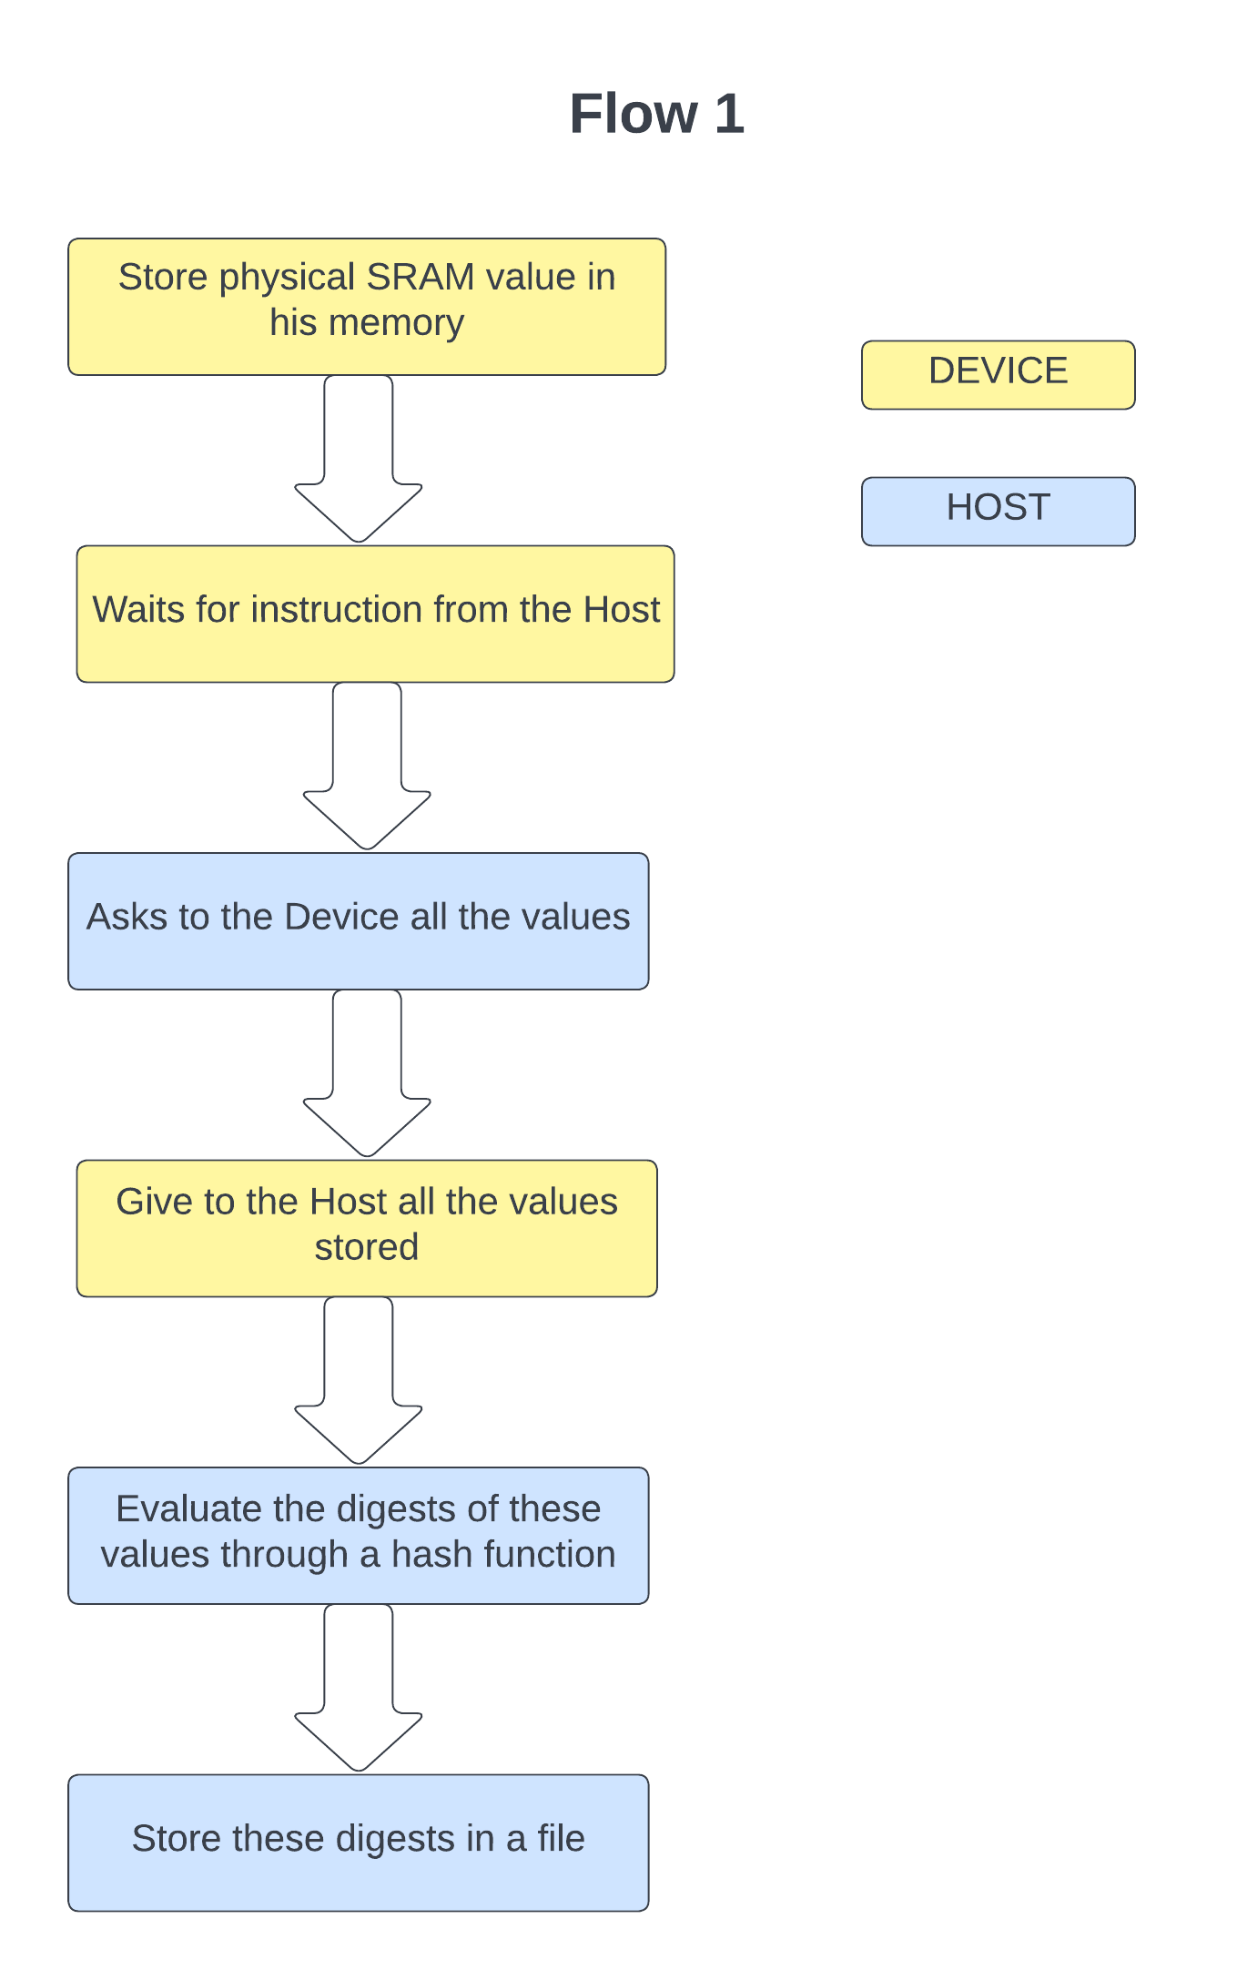
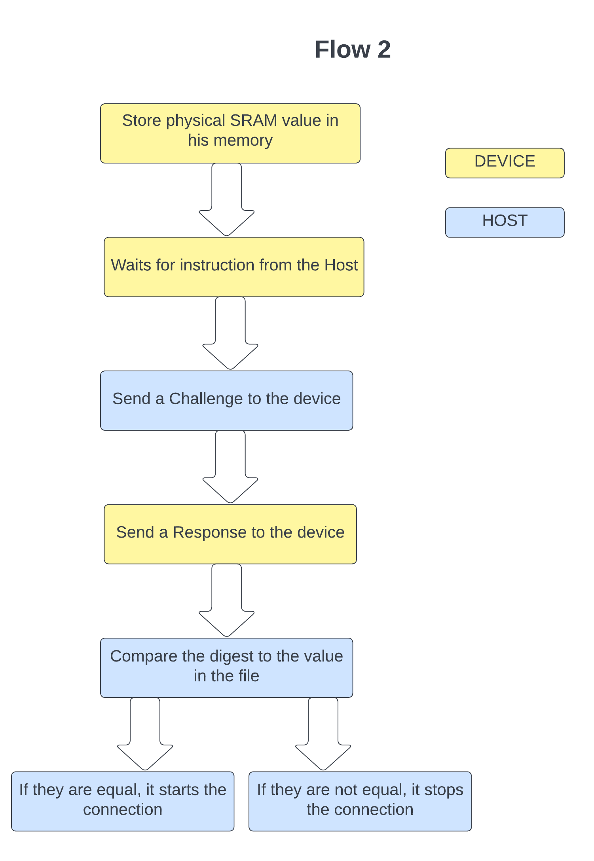
Implementation

Slide 7
Implementation

Slide 8
Implementation

Slide 9
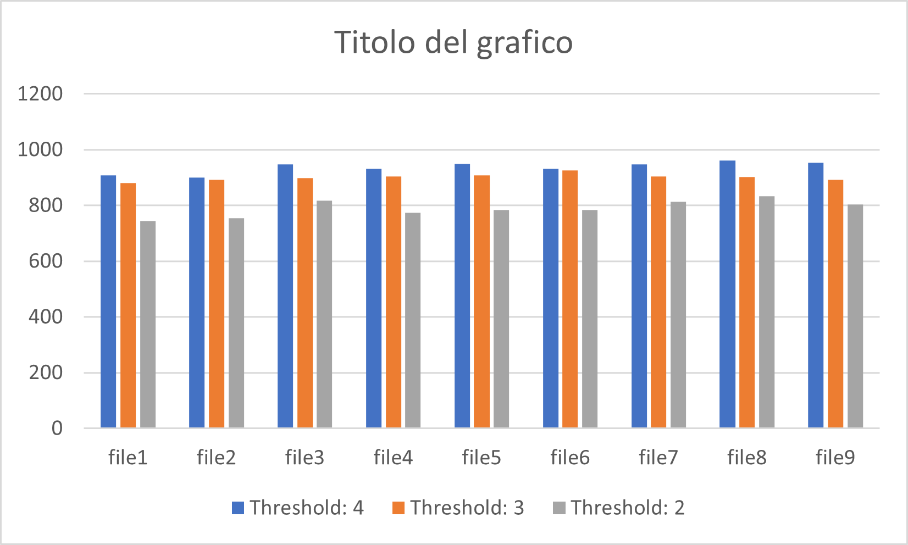
Results

Slide 10
Example on the board

